Slide 1
Machine Learning with energy datasets
Team 6:
Ann Sara Sajee
Gunjan Lalwani
Rishabh Jain

Slide 2
Exploratory Data Analysis (EDA)
It is an approach to analyze data sets to summarize their main characteristics, often with visual methods. EDA is for seeing what the data can tell us beyond the formal modeling. It is typically the first step of analysis.

Slide 3
Implementation

Slide 4
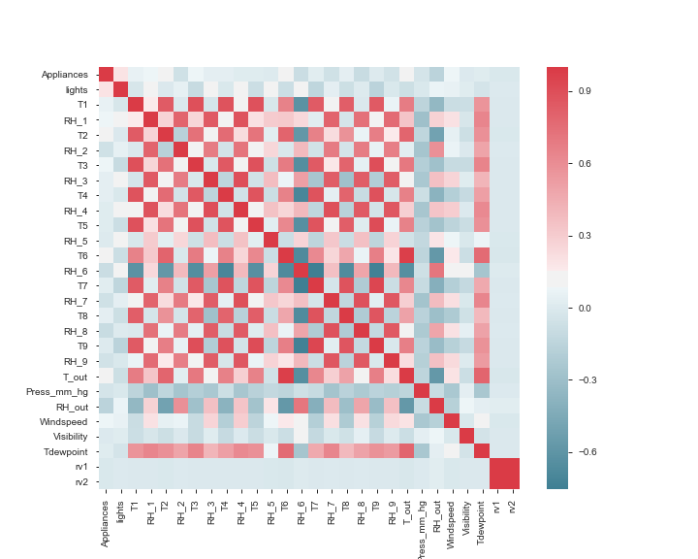
Correlation Matrix:

Slide 5
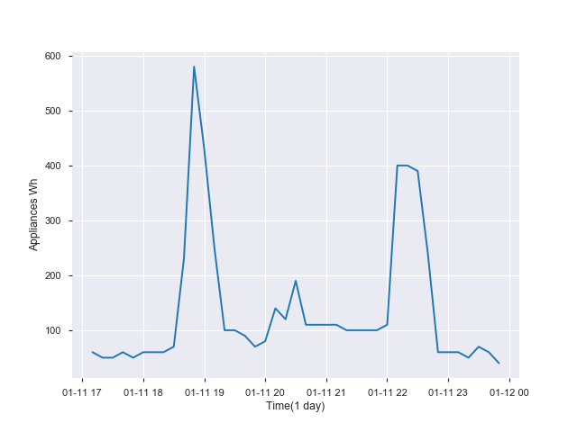
LINE PLOT:
Daily energy consumption by appliances
This graph shows that on 11th Jan around 7 pm there was high appliance energy consumption.

Slide 6
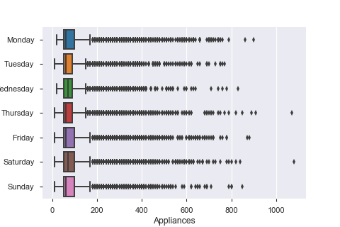
BOX PLOT:
Week day wise appliances energy consumption
Thursdays and Saturdays have high energy consumption
The median of all the days fall around 130-150 Wh
Wednesday is the least energy consumption day

Slide 7
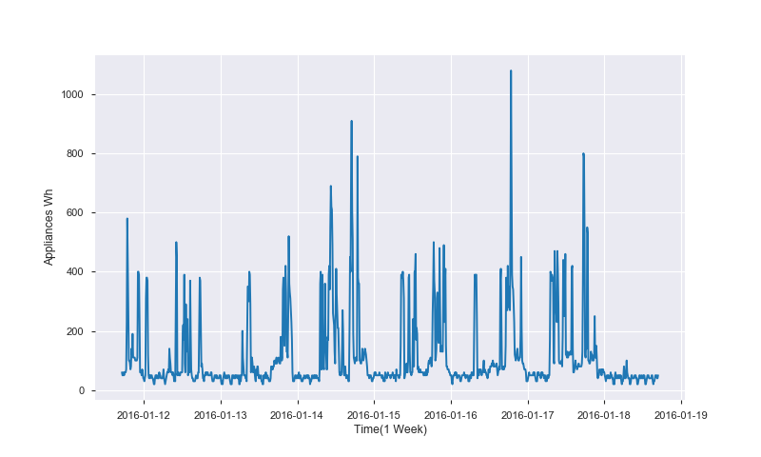
LINE PLOT:
1 Week appliance energy consumption

Slide 8
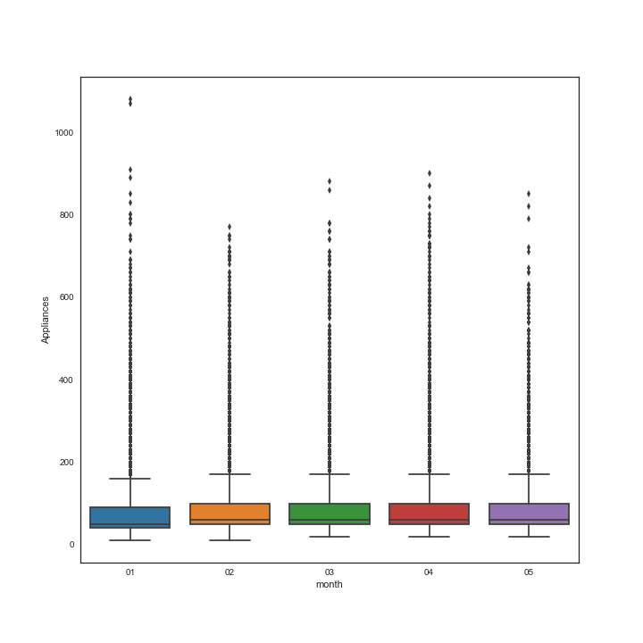
BOX PLOT:
Monthly appliance energy consumption
Highest energy consumption happens in the month of January.
Lowest in February

Slide 9
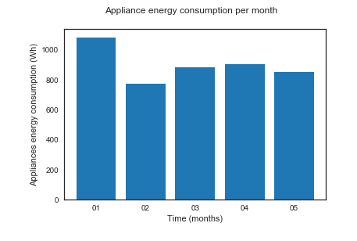
BAR PLOT:
Monthly appliance energy consumption

Slide 10
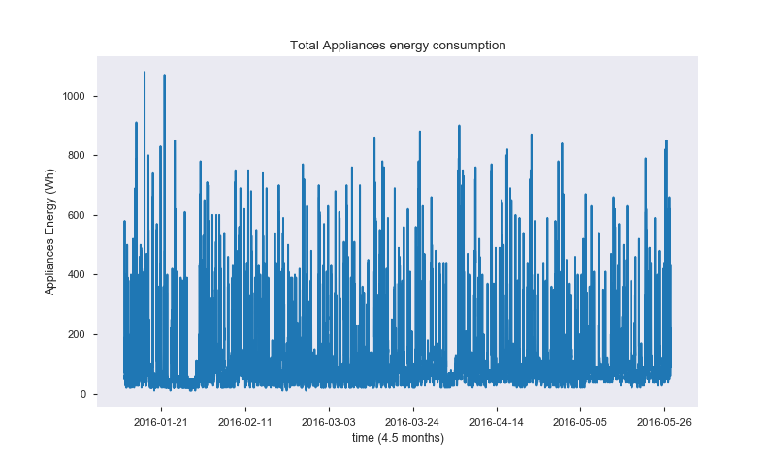
LINE PLOT :
Total energy consumption by appliances over 4.5 months
This graph shows that the month of Jan has highest peak indicating highest consumption of about 1100 Wh.

Slide 11
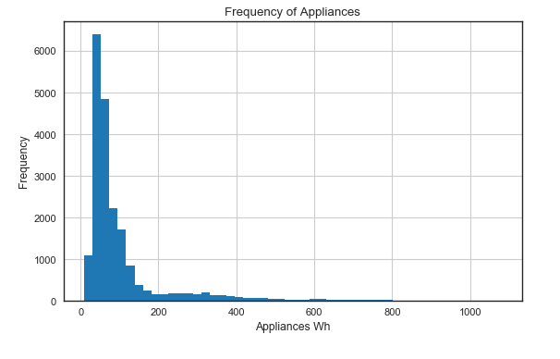
FREQUENCY PLOT:
Frequency of appliance energy consumption
This graph shows that appliances with less than 200 Wh energy consumption are mostly used.

Slide 12
After doing EDA we get better understanding of the energy dataset and relationship between different variables.

